Slide 1
Recipe_Manager
Forked from RedTiger26’s “foodmanager”
New coding done by: Jackson Draper

Slide 2
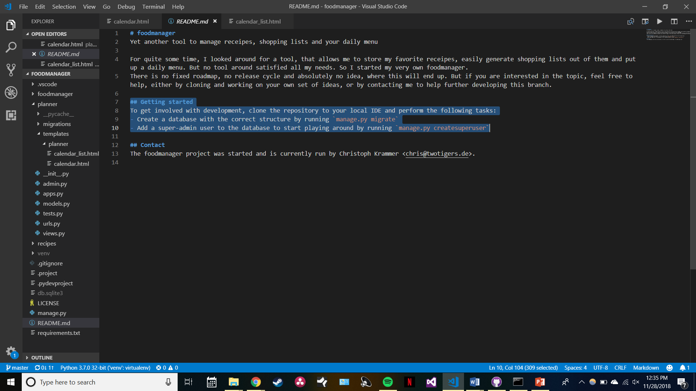
Original README Instructions…

Slide 3
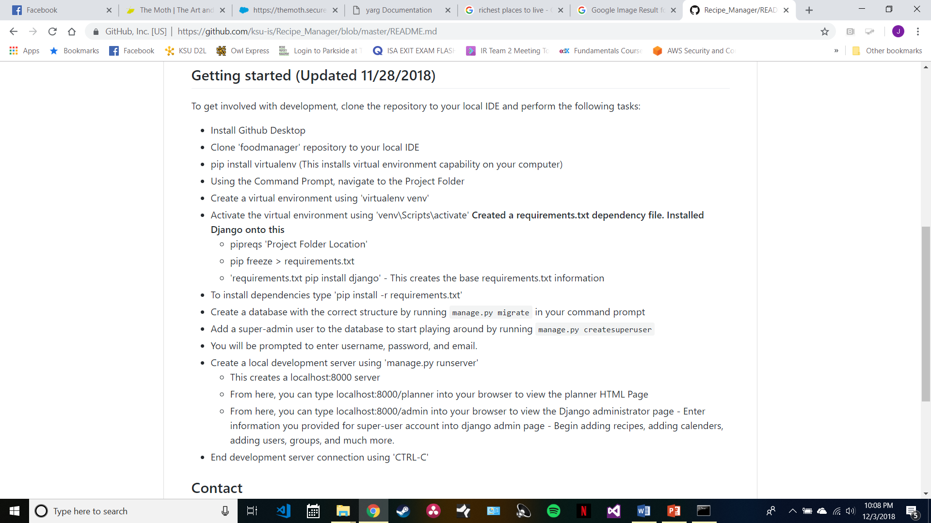
Updated README

Slide 4
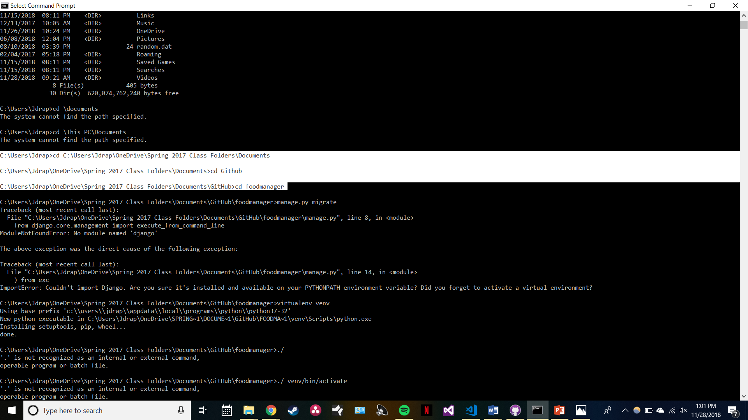
Navigated to Project Folder

Slide 5
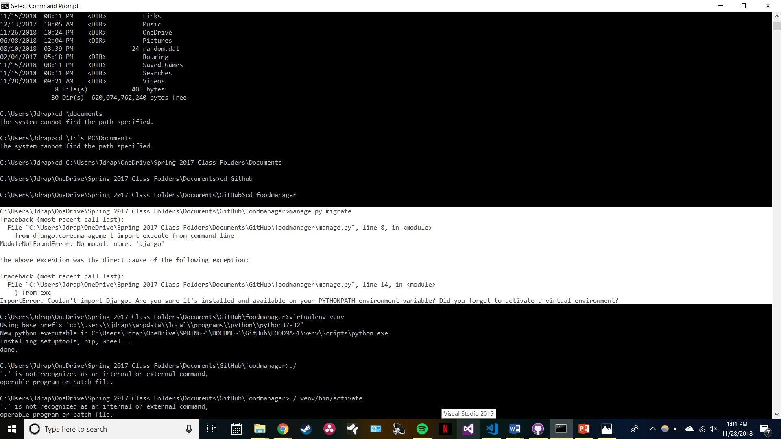
Followed original README instructions

Slide 6
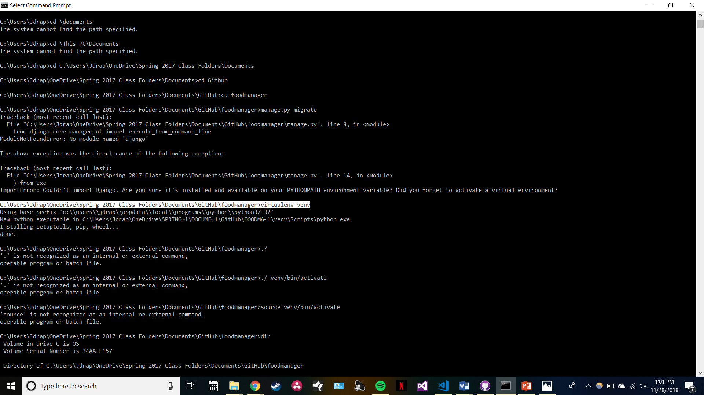
Created a virtual environment for this project

Slide 7
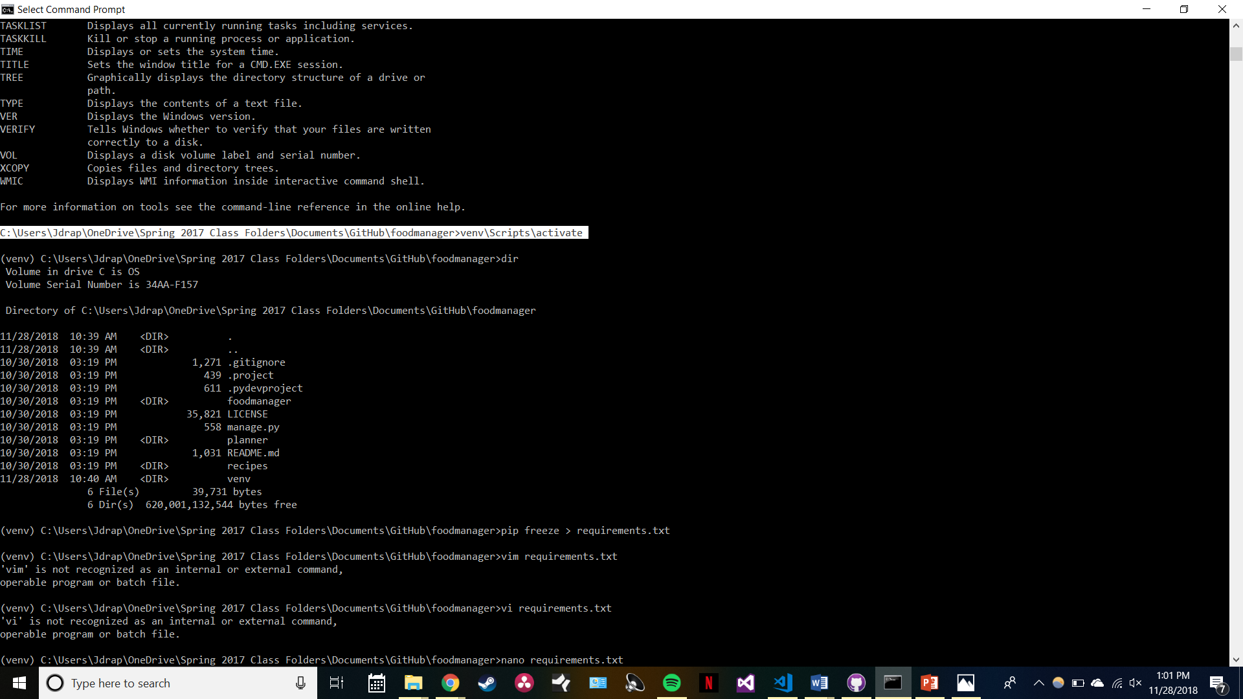
Activated the Virtual Environment

Slide 8
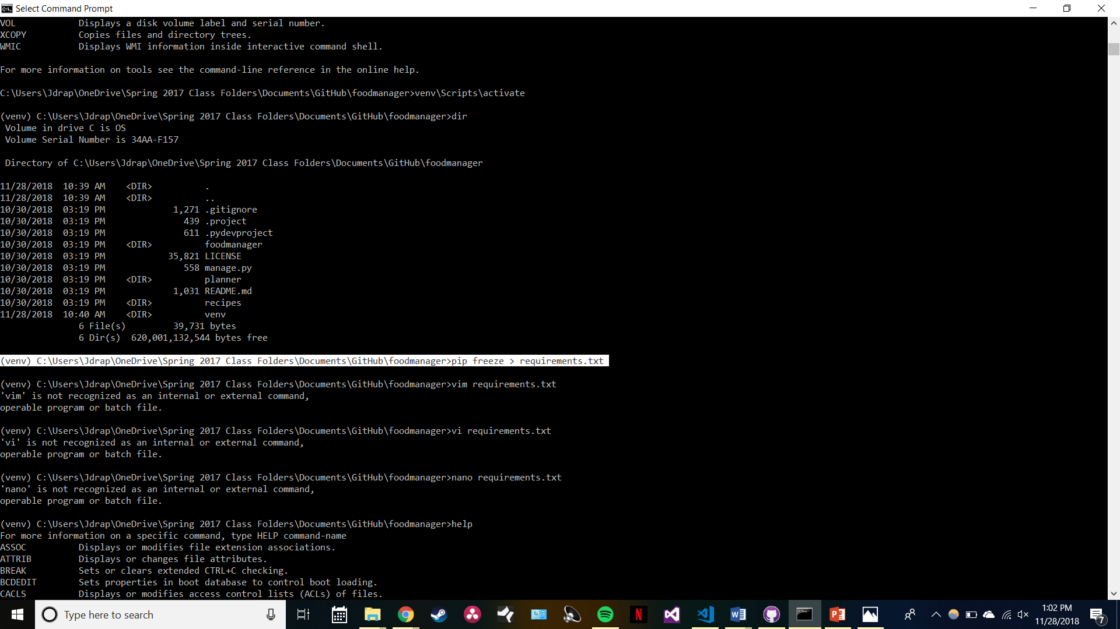
Created a dependency file What dependencies are required to run this application?

Slide 9
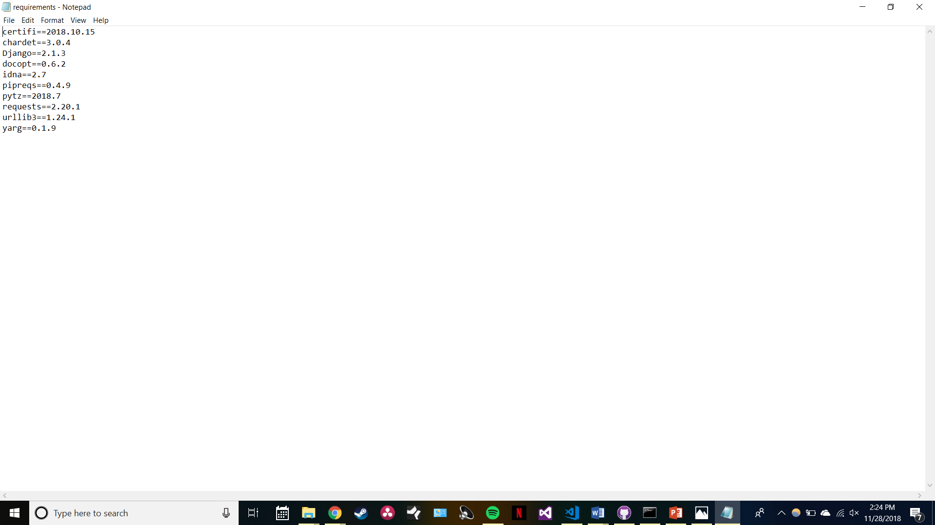
Automated Dependency file created

Slide 10
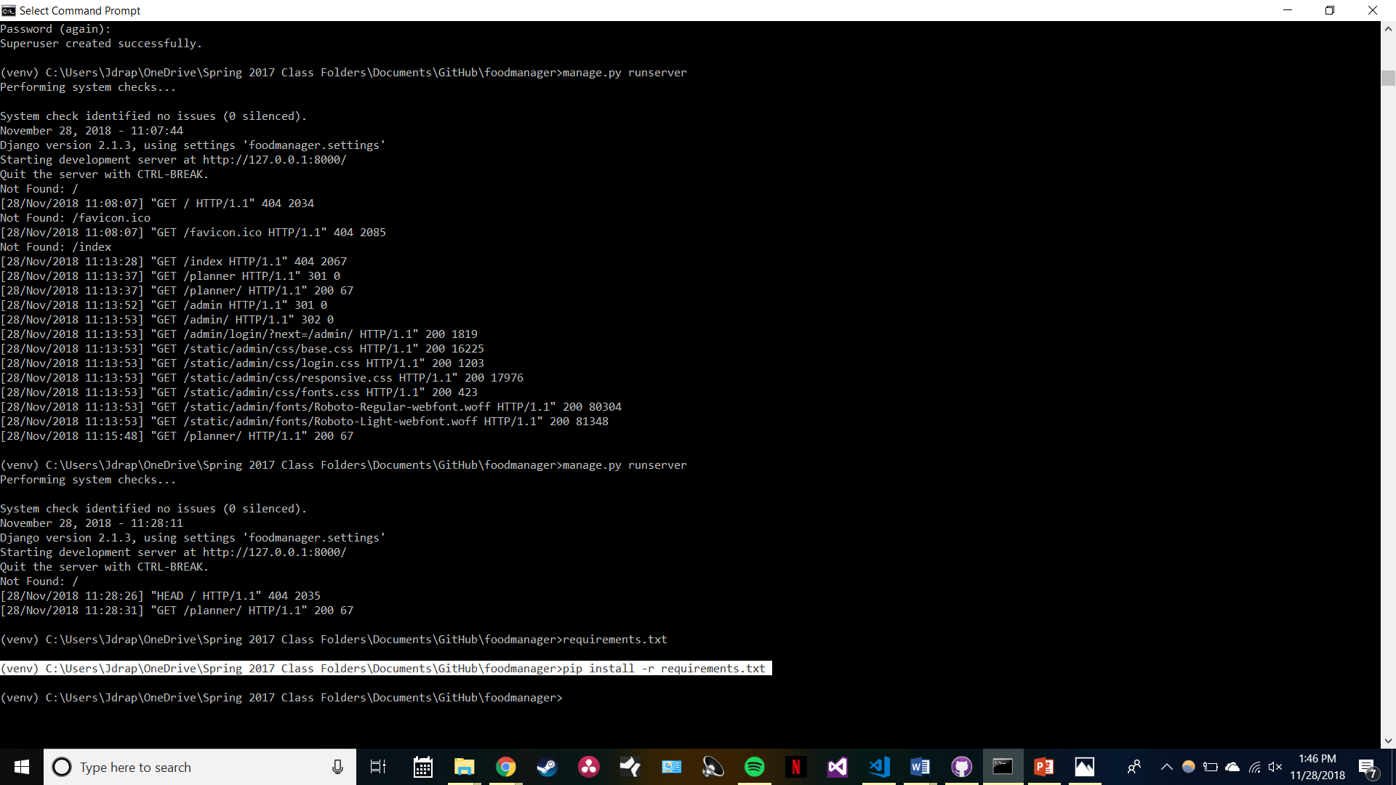

Slide 11
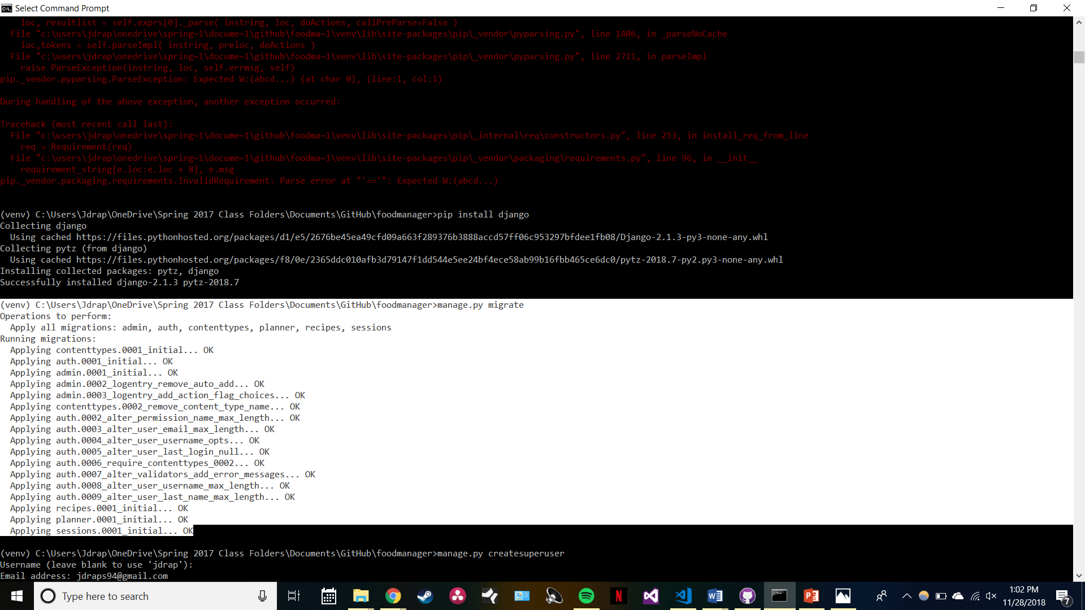
Migrated all required code into my Virtual Environment

Slide 12
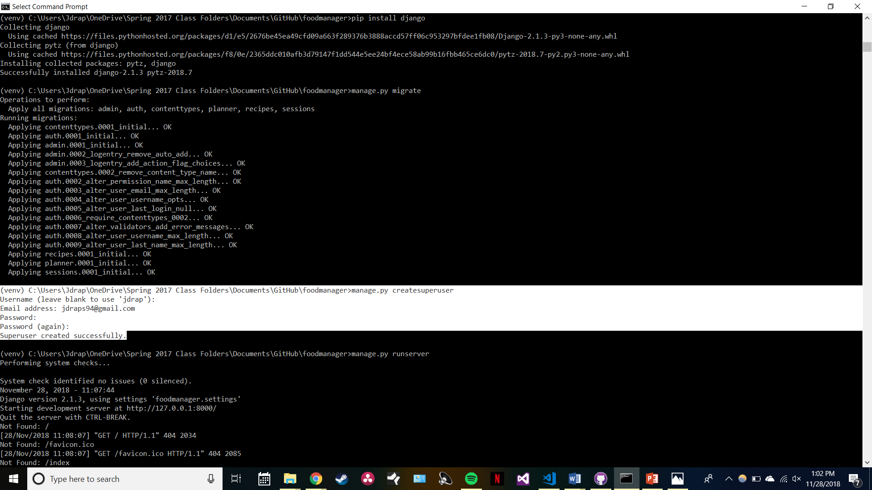

Slide 13
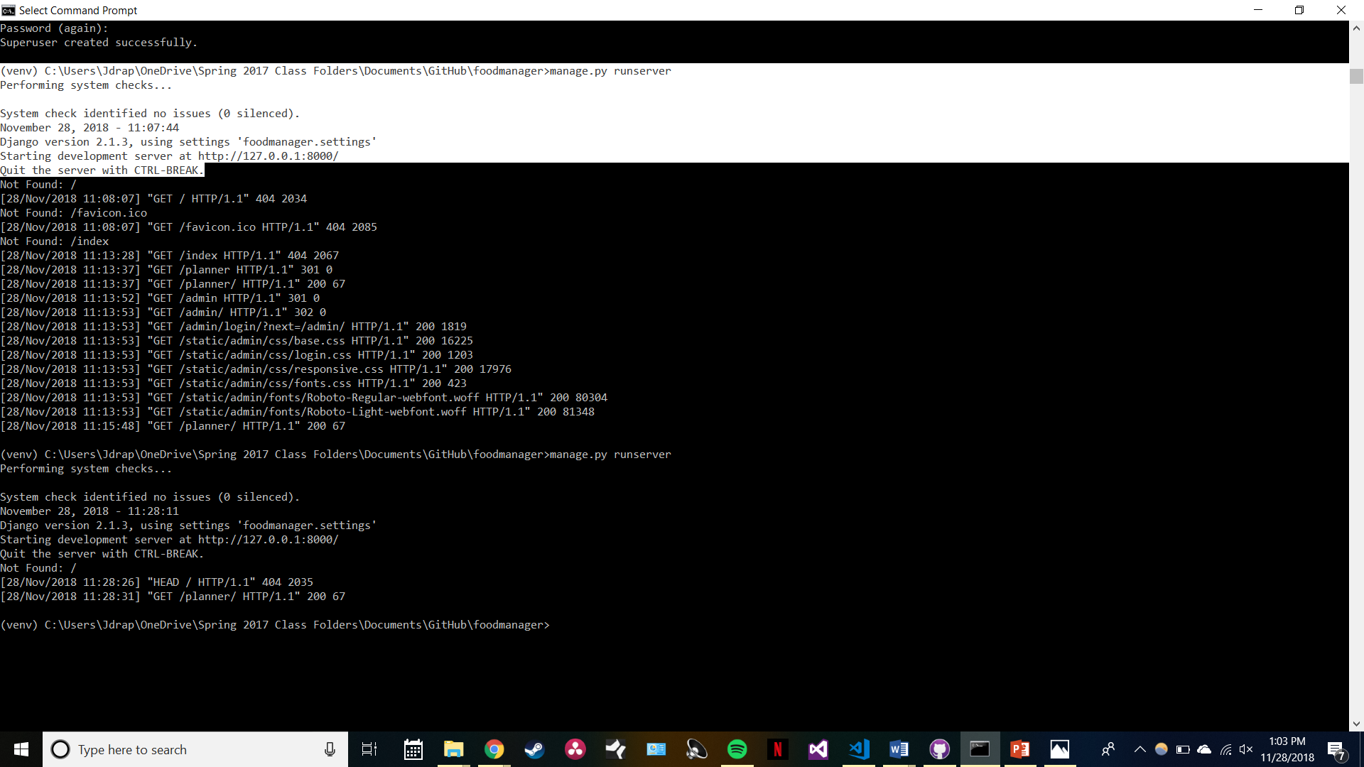

Slide 14
Future Goals:
Near-Future:
Add HTML files for all recipes
Including pictures of food, instructions, etc..
Beyond this year:
Create image recognition
Taking photos of food in your pantry and generate recipes based on it
Have a user base adding recipes to the database for others to use

